Slide 1

Department of Software Engineering Capstone Project Phase B Braude College of Engineering, Israel Project 24-2-R-4
Anomalies Detection Using Graph Diffusion Model
Capstone Project Phase B
Students:
Roei Nizri – RoeiNizri1@gmail.com, 318260742
Ran Polac – RanPolac@gmail.com, 318265808
Supervisors: Dr. Renata Avros, Prof. Zeev Volkovich
Notes:
Hello to everyone, My name is Ran Polac , My partner is Roei Nizri, and we are excited to share the results of our research on Anomalies detection using graph Diffusion Models.
In the next couple of minutes , we will explore how the methods we've learned about can be applied to detect and classify anomalies in several Databases.

Slide 2
Table of Contents
Introduction
Background
The Model:
Pre-process, General process, Dataset, Training
Results
Conclusion
Demonstration
Notes:
In Phase 1 of our research project, we identified that self-citations, collaborations, and field-specific patterns create structured relationships in citation networks. This complexity makes it challenging to distinguish true anomalies from natural citation behaviors. From here, we will remember some concepts of Graph Diffusion and anomaly detection and dive into the model, explaining how it addresses these complexities to improve anomaly detection.

Slide 3

Graph Anomaly Detection
The process of identifying unusual nodes, edges, or substructures in a graph.
Unlike standard anomaly detection, it considers both node attributes and structural relationships.
Used in networks, transaction graphs, cybersecurity, and various real-world graph-structured data.
Notes:
Graph anomaly detection is the process of identifying irregular patterns, unusual behaviors, or unexpected structures within a graph. Graphs are a powerful way to represent real-world data, where entities (nodes) are connected through relationships (edges). Unlike traditional anomaly detection in tabular data, graph anomaly detection must account for both individual node attributes and structural relationships between entities.
Unlike standard anomaly detection, which deals with independent data points, graph anomaly detection requires analyzing both individual node/edge properties and the overall structure of the graph. Anomalies can emerge in different ways—some may involve isolated suspicious nodes, while others arise from subtle changes in connectivity patterns within the graph.

Slide 4
The Challenges
Complexity :Academic networks consist of vast and complex datasets with intricate relationships between publications and authors. Detecting anomalies in citations is challenging.
Volume: The sheer volume of publications and the complexity of citation networks make it difficult to process and analyze data efficiently.
Scalability: Ensuring that our detection methods can scale with the growth of academic publications is crucial.
Detecting Anomalies: Differentiating between legitimate citation behaviors (such as self-citations or collaborative citation clusters) and true anomalies requires sophisticated techniques to avoid false positives and ensure accuracy.
Notes:
Challenges in Anomaly Detection
Complexity:
The dataset has complex relationships which makes it harder to detect anomalies.
Volume: With a large number of data, processing the data efficiently is challenging. Additionally, there may not be enough data for certain types of anomalies..
Scalability: As the dataset grows, our detection methods need to scale to handle the increasing volume.
Detecting citations: It’s important to differentiate between normal citation patterns and unusual ones that might indicate fake citations (false positives).
These challenges highlight why anomaly detection in the dataset is both difficult and essential.

Slide 5
Motivation
Motivational Framework
Objective Clarity
Application Enhancements
Notes:
Our project is driven by three main factors:
Motivational Framework: We’re using graph diffusion models because they effectively capture complex relationships, which is crucial for accurate anomaly detection.
Objective Clarity: Our main goal is to improve detection accuracy while handling various graph structures and sizes smoothly.
Application Enhancements: We’re focused on enhancing analysis, ensuring quick responses in critical applications across different industries.
These points outline why we’re doing this project and what we aim to achieve.

Slide 6
Background

Slide 7
Graph Neural Networks (GNNs)
Graph Neural Networks (GNNs) have become essential for learning complex patterns and dependencies in graph-structured data.
Extend traditional convolutional networks to graphs by aggregating information from neighboring nodes.
Useful for anomaly detection in social and citation networks, where relationships define irregular patterns.
Notes:
Graph Neural Networks (GNNs) effectively detect anomalies by learning structural patterns in graphs. GCNs aggregate node information to capture relationships, but require large labeled datasets. Despite their advantages, GNNs face challenges with data imbalance and scalability in applications.

Slide 8
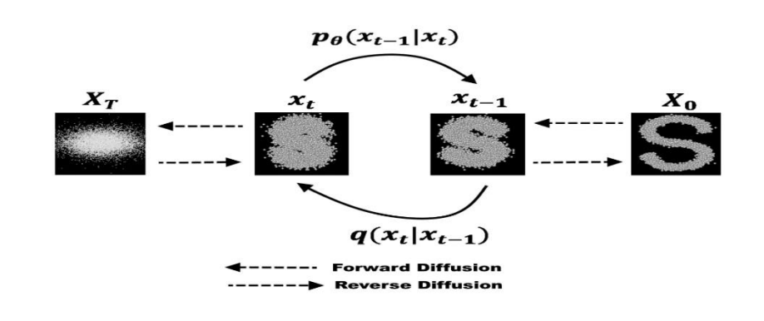
Diffusion models
Diffusion models were introduced in 2015 as a method to learn a model that can sample from a highly complex probability distribution.
The model has the ability to generate realistic graph structures and node features, which can be used to create synthetic anomalies.
Operates by adding noise to data points and then learning to reverse this process, effectively generating data points from noise.

Slide 9
A diffusion model-based graph generator
Simultaneously learns graph structures and node features in a multitask fashion.
Generates synthetic anomalous examples, enriching the dataset and balancing class distributions.
Improves anomaly detection models by providing more diverse and representative training data.
Notes:
The solution leverages advanced graph diffusion models and synthetic anomaly nodes to improve the detection of citations, aiming to uphold the integrity of academic research. Researchers have developed various algorithms that take advantage of the structural properties of graphs.
To address this issues, the study introduces a diffusion model-based graph generator capable of simultaneously producing graph structures and node features in a multitask fashion, focusing on generating synthetic anomalous examples.
By integrating these synthetic anomalies into the training dataset, we achieve a more balanced dataset, significantly enhancing the training and performance of downstream anomaly detection models.
The approach addresses the challenges of label imbalance and data insufficiency in graph anomaly detection, providing a robust framework for generating synthetic anomalies and improving the effectiveness of anomaly detection models.

Slide 10
Node Feature: Represents various attributes associated with the node, such as metrics or characteristics that describe its properties and behavior within the graph.
Node Timestamp: A temporal marker indicating when a specific event or interaction involving the node occurred, crucial for analyzing the temporal dynamics of the network.
Feature Normalization: Node features were normalized to maintain consistent scaling.
Pre Graph Construction: The dataset was transformed into an adjacent matrix format, allowing the model to effectively capture relationships between nodes.
Pre-process
Notes:
We aim to improve our anomaly detection system by adding synthetic anomaly nodes to the dataset for better training.
These nodes have four key components:
Node Feature: Describes different properties or behaviors of the node, like metrics or attributes.
Node Timestamp: A timestamp showing when an event happened for the node, which helps in tracking changes over time.
Feature Normalization: Node features were normalized to maintain consistent scaling.
Pre Graph Construction:
The dataset was transformed into an adjacent matrix format, allowing the model to effectively capture relationships between nodes.
After pre-processing, The model creates a graph from the dataset and adds extra connections between nodes with the same author or source.
This helps show more relationships between citation and complex graph structures is captured in different granularity levels.

Slide 11
Process

Slide 12
Dataset Preparation: Data collection involved identifying relevant graphs and pre-processing steps such as normalization and feature selection.
Graph Construction: Constructed directed and undirected graphs reflecting relationships, emphasizing edge weights and node attributes for accurate analyses.
Anomaly Detection Workflow: Graph autoencoders with diffusion models to systematically identify and analyze anomalies.
Notes:
Our engineering process consists of three main steps:
Dataset Preparation: We begin by collecting relevant graphs and pre-processing them using steps like normalization and feature selection to ensure the data was ready for analysis.
Graph Construction: We than build graphs that include both one-way (directed) and two-way (undirected) connections to represent the relationships in the data, with a focus on edge weights and node attributes for more accurate analysis.
Anomaly Detection Workflow: Finally, we used a structured process that combines graph autoencoders with diffusion models to find and analyze anomalies. This approach ensures our method is thorough and effective.

Slide 13
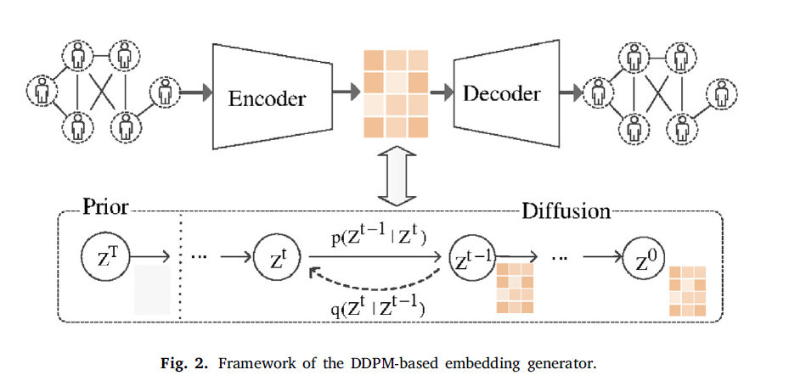
The Model
Graph Construction
GAE
DDPM
Notes:
Based on the inherent architecture, the project also is composed of three main modules:
Graph Construction:
Each node should have features such as text embeddings, author information, and publication details. Create edges based on relationships.
GAE:
We use a graph neural network (GNN) to encode the graph into a latent space, capturing the structural and feature information. Train the autoencoder to reconstruct the original graph from the latent representation.
DDPM: Implement a diffusion model in the latent space to generate synthetic anomalies. This involves iterative noise addition and removal to create synthetic nodes that resemble anomalies. We ensure the model can generate nodes with specific labels (anomalous or normal).

Slide 14
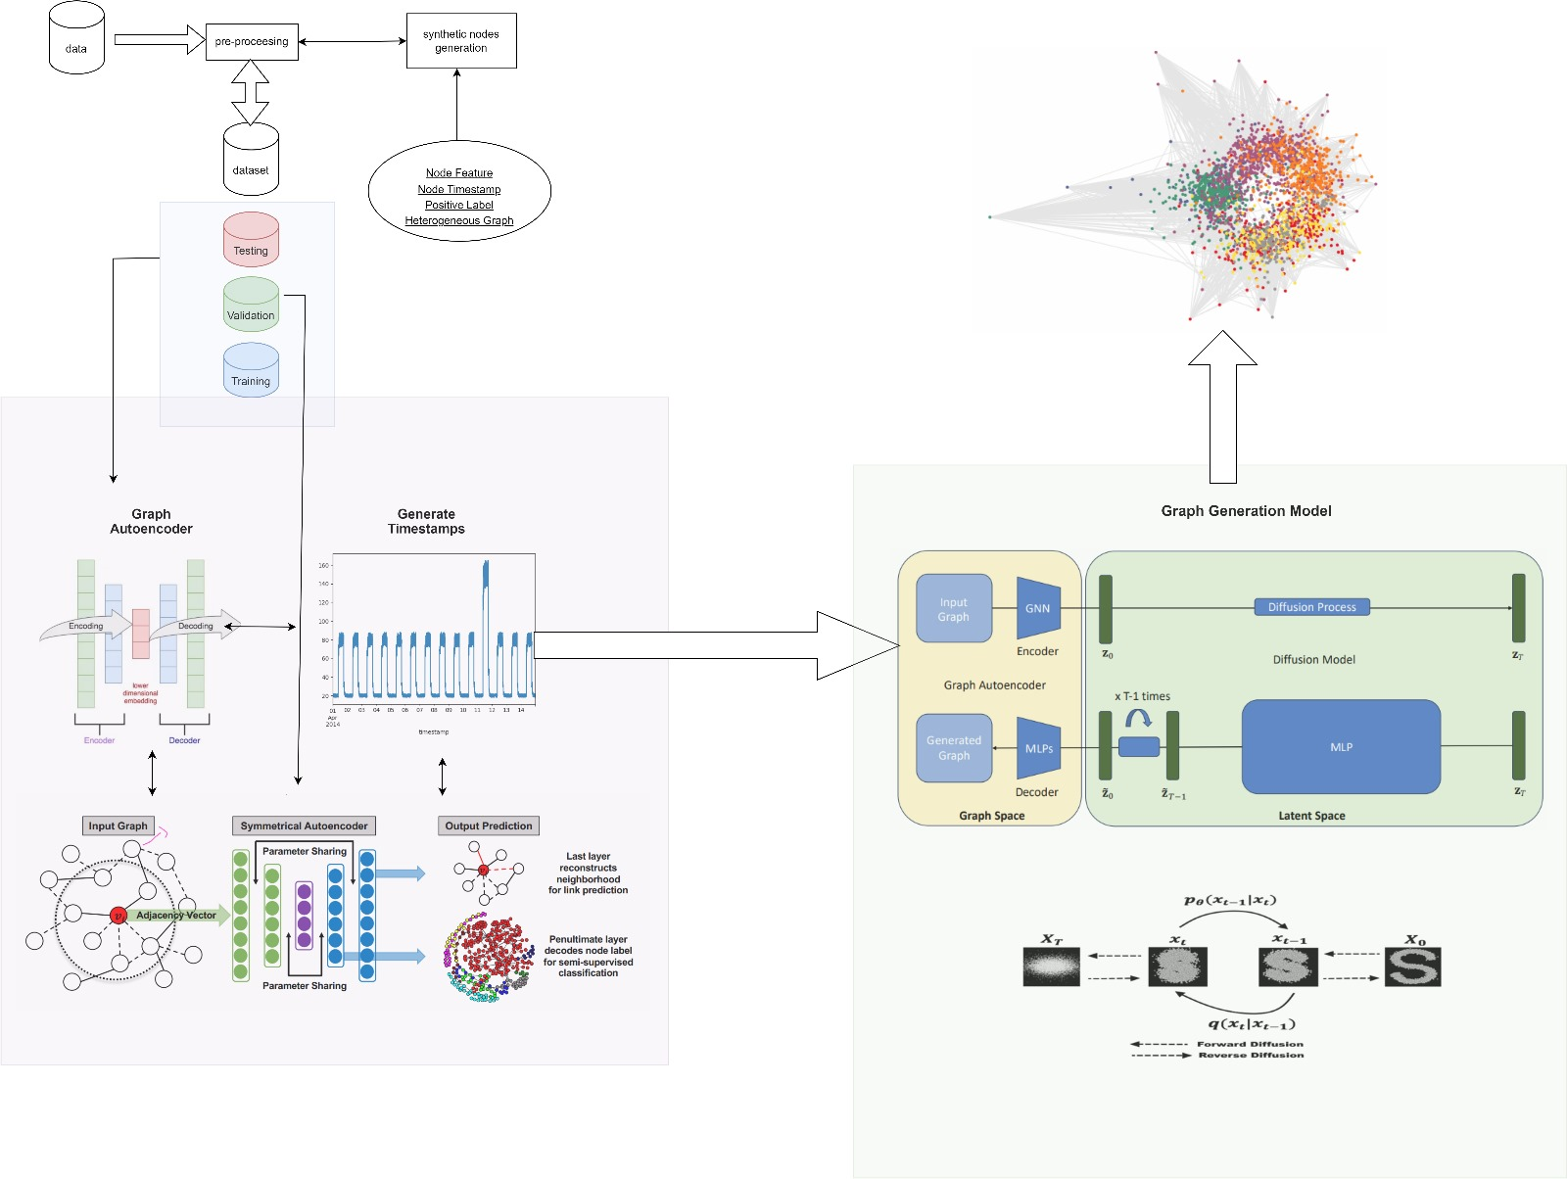
Notes:
The architecture of the model
Data and Pre-processing: We start with data collection and pre-processing, where we prepare the dataset and generate synthetic nodes with features like timestamps and author as ran explained.
Graph Autoencoder: The output graph from the previous stage is fed into a graph autoencoder, which encodes the graph structure and node features into a latent space.
The autoencoder also maintaining context in the data.
Diffusion Techniques: The encoded data is the input of the diffusion model, which refines the latent space, making the detection of anomalies faster.
Output and Analysis: Finally, the data is visualized so we can identify anomalies easily and analyzed.
As you can see clearly the anomalies in this picture.

Slide 15
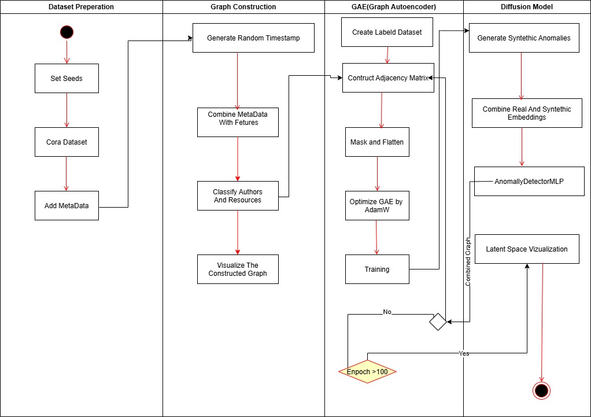
Activity Diagram
Notes:
Diffusion Model in the Latent Space to Generate Synthetic
Adds noise to the data over multiple steps (forward diffusion). Learns to reverse this process to recover (or generate new) data. Below, we show a very simplified placeholder approach to create “anomalies”:
We take latent embeddings z. We sample random noise vectors, add them to z. We label some of these “anomalous” if their noise level crosses a threshold or by random sampling.
Build a Classifier for Anomaly Detection - AnomalyDetectorMLP
Train the model that classifies whether a node is “anomalous” or “normal” based on the latent vectors. Our training set will consist of: Real nodes (latent z) labeled as normal (0).
Synthetic nodes (latent synthetic_z) labeled as anomalies (1).

Slide 16
Datasets – Cora And CiteSeer
represents a citation network, where nodes correspond to scientific publications and edges represent citations.
Cora - consists of 2708 scientific publications classified into one of seven classes. The citation network consists of 5429 links.
CiteSeer-consists of 3327 scientific publications classified into one of 6 classes. The citation network consists of 4732 links.
Widely used in graph-based machine learning, including node classification, link prediction, and anomaly detection.
Notes:
At the beginning of the project, we worked with a single dataset – Cora.
However by professor Zeev consulting, we add CiteSeer to evaluate how our model performs on different datasets. Incorporating both datasets allowed us to examine the flexibility and effectiveness of our approach in different graph structures.

Slide 17
Binary Cross-Entropy (BCE)
Purpose:
Fundamental loss function.
Why BCE?:
A solid baseline from which to assess and refine the model's performance.
Functionality:
Measures the divergence between predicted probabilities and actual binary outcomes.
Notes:
The training process was guided by binary cross-entropy (BCE) loss for adjacent reconstruction, ensuring accurate graph structure learning. The BCE loss was computed on the upper triangular part of the adjacency matrix to avoid redundant calculations.

Slide 18
Hyper-Parameters
Loss Functions:
Epochs: 100
Batch Size: 64
Optimizer: GAE
Binary Cross-Entropy.
Weighted Binary Cross-Entropy.
Synthetic nodes: 500
Notes:
BY ADAMW

Slide 19
Results

Slide 20
Running Method
We tested two different methods in our project:
Standard Run – Running the model with a fixed dataset configuration.
Multiple Running Approach – Iteratively changing the number of anomalies and observing how the model adapts and improves over multiple runs.
By comparing these approaches, we gained deeper insights into how graph diffusion models handle anomaly detection under varying conditions.

Slide 21
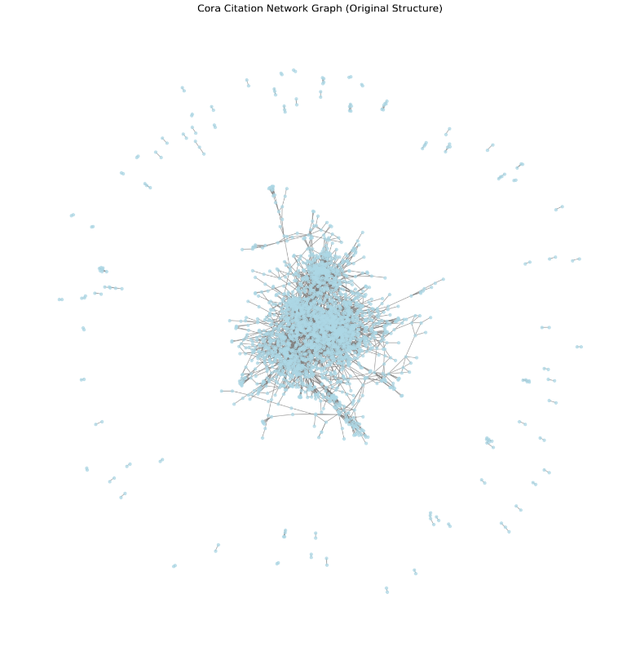
Citation Network Graph
Notes:
The central dense region likely represents a well-connected group of papers frequently citing each other.
The outliers (nodes far from the center) could be potential anomalies, indicating unusual citation patterns.

Slide 22
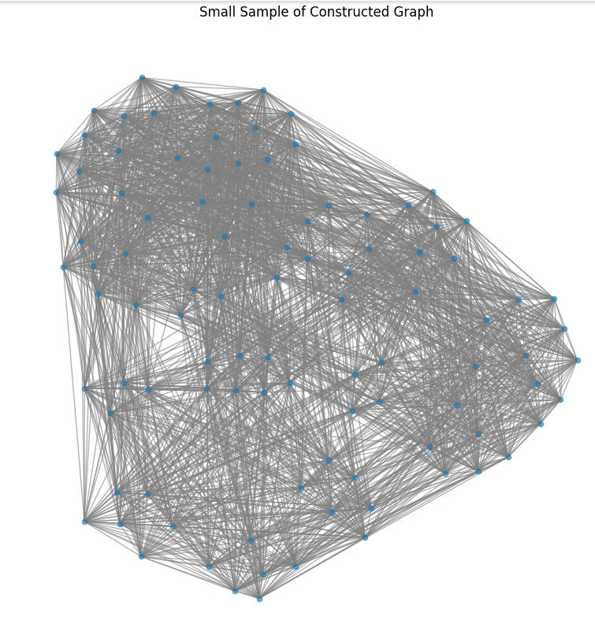
Cora
Notes:
Nodes: Represent papers (or entities) in the Cora dataset.
Edges: Represent citations or relationships between nodes.

Slide 23
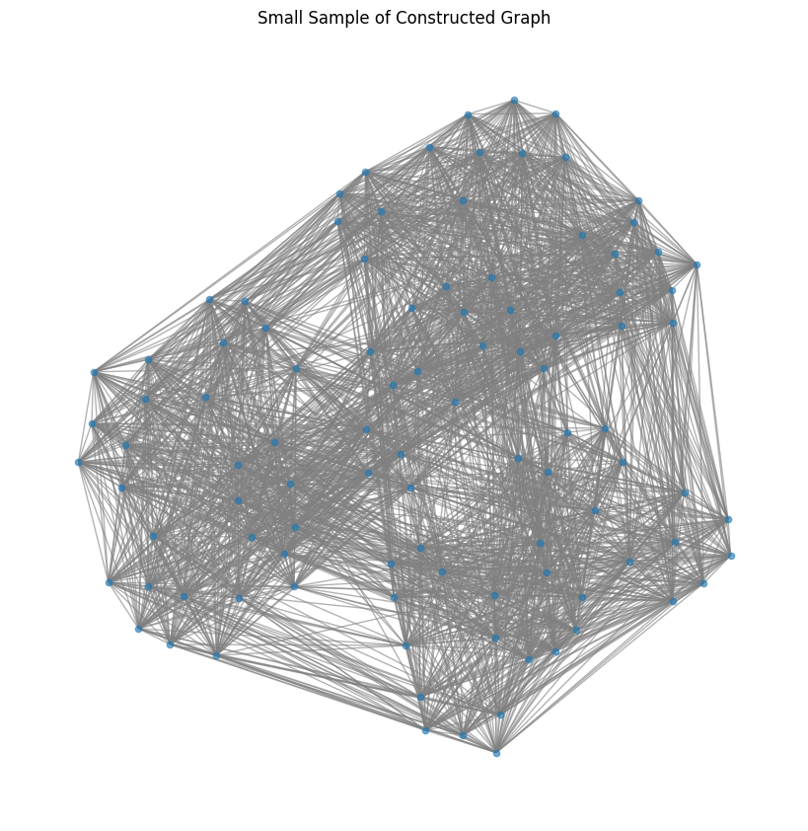
CiteSeer
Notes:
Nodes: Represent papers (or entities) in the Citeseer dataset.
Edges: Represent citations or relationships between nodes.

Slide 24
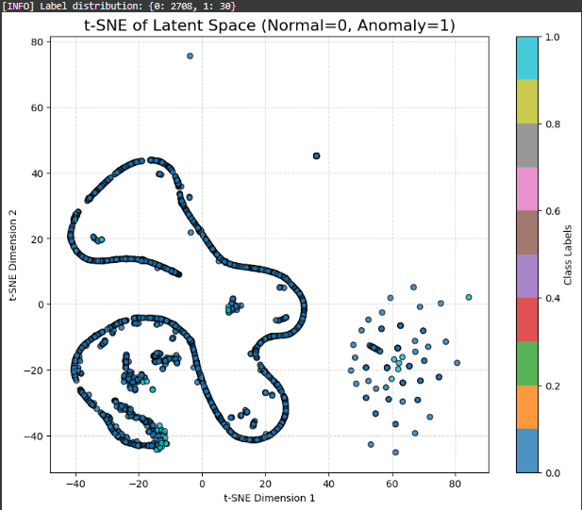
Notes:
The anomalies detected are structurally different from normal nodes, proving that the model effectively identifies citation irregularities.
The diffusion-based anomaly detection method successfully separates normal and anomalous data.

Slide 25
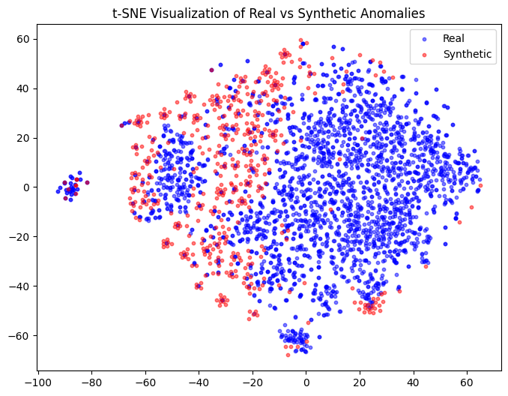

Slide 26
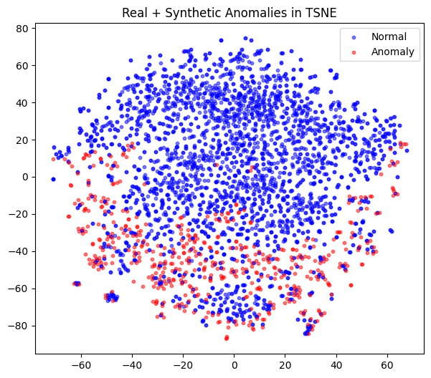

Slide 27
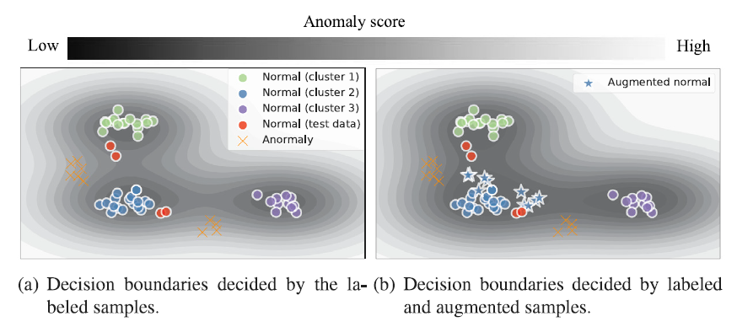
illustrates the effect of synthetic data on anomaly detection decision boundaries.

Slide 28
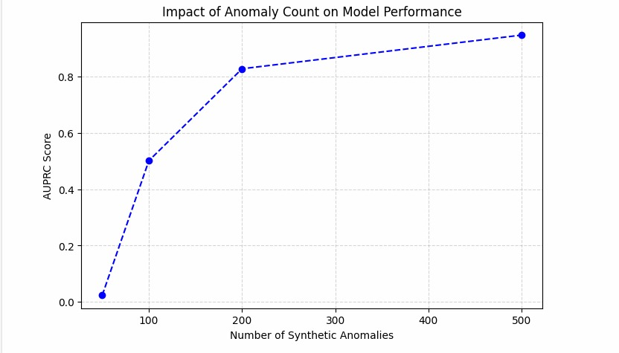
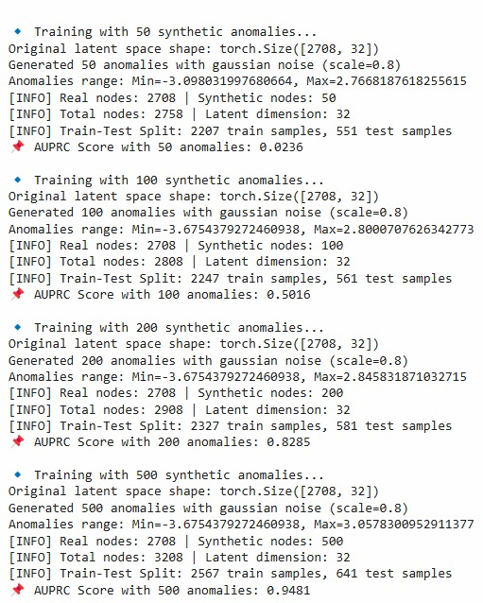
Notes:
With a small number of synthetic anomalies, the model struggles to learn a proper anomaly pattern.
Increasing the number of anomalies initially reduces AUPRC, likely due to increased complexity and overfitting risks.
However, at 200 and 500 anomalies, the model learns stronger anomaly representations, leading to better performance.
500 anomalies provide the best results, confirming that having enough anomalies improves model generalization.

Slide 29
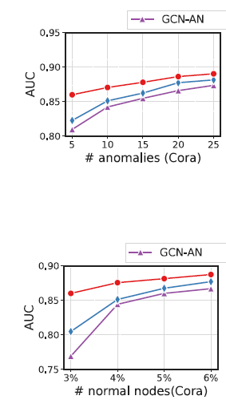
Notes:
As the number of anomalies increases from 5 to 25, the AUC also increases.
This suggests that the model benefits from having more anomaly examples during training, making it better at distinguishing anomalous nodes.
The red line (Graph Autoencoder - GAE) consistently outperforms the others.
The purple and blue lines (KNN, Logistic Regression) slightly improves but remain lower in performance

Slide 30
Testing
Factor | Description
Sample Size (Dataset Size) | Training set size: ~2200-2500 nodes (varies with anomaly count) Test set size: ~500-600 nodes
Gaussian Noise Applied? | Yes, synthetic anomalies are generated with Gaussian noise
Noise Scale | 0.8 (used when generating synthetic anomalies)
Models Compared | Isolation Forest, Logistic Regression, KNN (with PCA), Graph Autoencoder
Train-Test Split | 80% Train, 20% Test
Notes:
In the testing and evaluation phase, we focus on three main areas:
Evaluation Metrics: We use key metrics like AUROC and AUPRC like we learned in Zeev data mining course to measure how well the model classifies anomalies across different datasets.
Performance Comparison: We compare methods against baseline models to ensure it offers good idea on anomaly detection.
Dataset Results: We analyze results across various datasets to see how different structures impact performance.
Project Success Criteria: For us,to be considered successful, the model needs to detect at least 90% of suspected anomalies between graphs.
If it falls short, we’ll fine-tuned the model and add tests.

Slide 31
Model | Trained On? | Uses Graph Structure? | Handles High Dimensions? | Performance
Isolation Forest | PCA-reduced embeddings (10D) | No | Struggles with 10D features | Fails completely (AUROC ~0.02)
Logistic Regression | Full embeddings (64D) | No | Not good for complex patterns | Weak performance (~0.53 AUROC)
KNN (with PCA) | PCA-reduced embeddings (10D) | No | Learning distances well | Performs well (AUROC ~0.96)
Graph Autoencoder (GAE) with DDPM | Learned graph embeddings (64D) | Yes | Learns relationships | Best model (AUROC ~0.98)

Slide 32
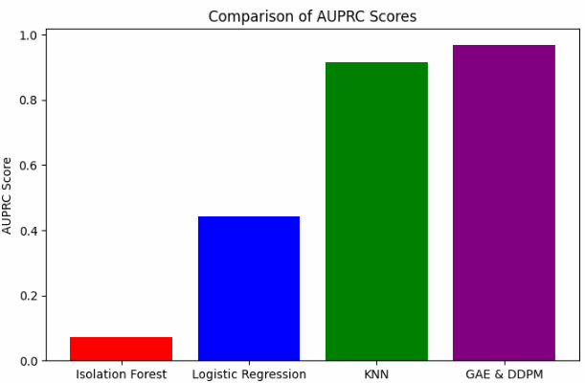
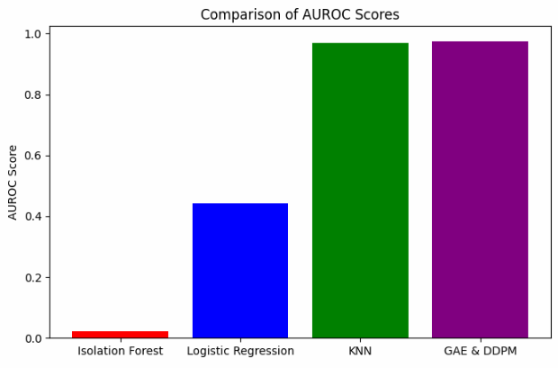
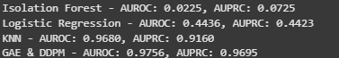
Notes:
Interpretation:
Graph Autoencoder (purple) and KNN (green) achieve the highest AUROC (~0.98), confirming their strong performance in distinguishing anomalies.
Logistic Regression (blue) shows moderate performance.
Isolation Forest (red) fails miserably (AUROC ~0.02), meaning it struggles to identify anomalies correctly in a graph-based setting.

Slide 33
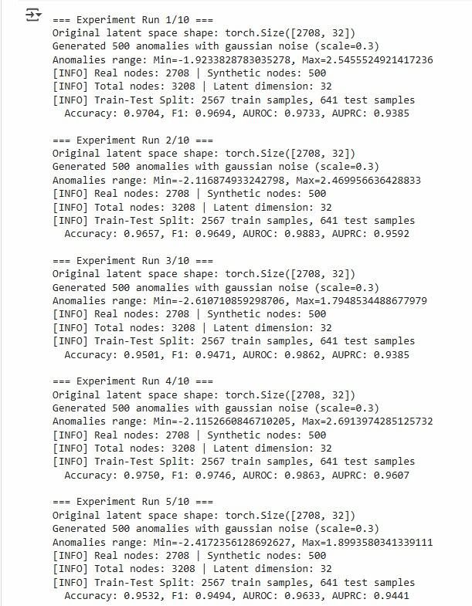
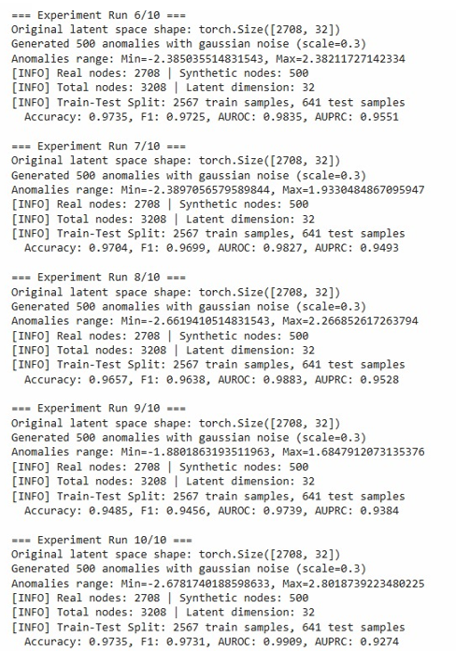
Results – Multiple Running
Notes:
Significance:
High accuracy and F1-score (~0.963) indicate that the model performs well in distinguishing anomalies.
AUROC and AUPRC are lower than accuracy but still very strong (~0.94-0.98), meaning that the model maintains good performance despite class imbalance.
The results confirm that introducing synthetic anomalies and Gaussian noise significantly improves anomaly detection accuracy.

Slide 34
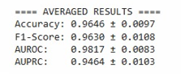
Results – Multiple Running
High accuracy and F1-score (~0.963) indicate that the model performs well in distinguishing anomalies.
AUROC and AUPRC are lower than accuracy but still very strong (~0.94-0.98), meaning that the model maintains good performance despite class imbalance.
The results confirm that introducing synthetic anomalies and Gaussian noise significantly improves anomaly detection accuracy

Slide 35
Conclusions
Through these experiments, we demonstrated that graph diffusion models effectively enhance anomaly detection by capturing both local and global structures in citation networks.
The ability to generate synthetic anomalies further improved performance, addressing challenges like label imbalance and data sparsity.
This study highlights the potential of advanced graph-based models in handling real-world anomaly detection tasks and opens the door for future research into scalability, efficiency, and applicability in other domains.
Notes:
In this project, we explored anomaly detection using graph diffusion models, starting with the Cora dataset and later expanding to CiteSeer to evaluate the model’s adaptability to different graph structures.

